Slide 1
Upload Mockup Screens
1) TAC File Upload
2) View TAC File Upload Status
3) Claim File Upload
4) View Claim File Upload Status
5) Job Schedule Enquiry

Slide 2
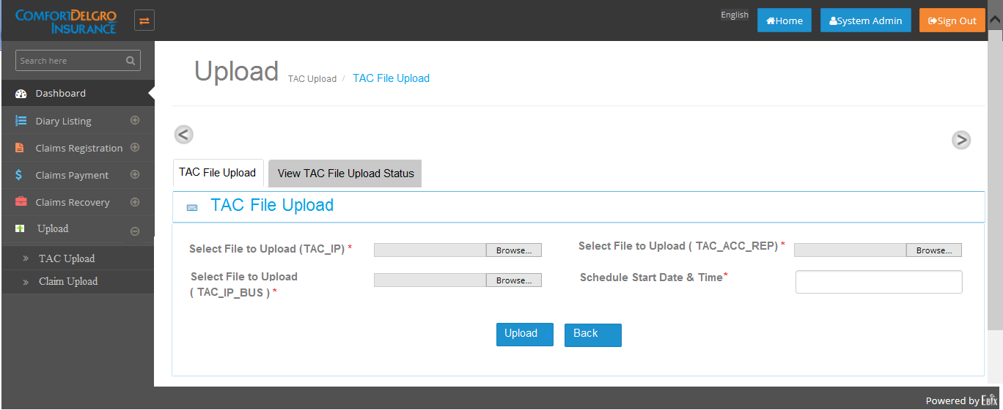
1) TAC File Upload Screen

Slide 3
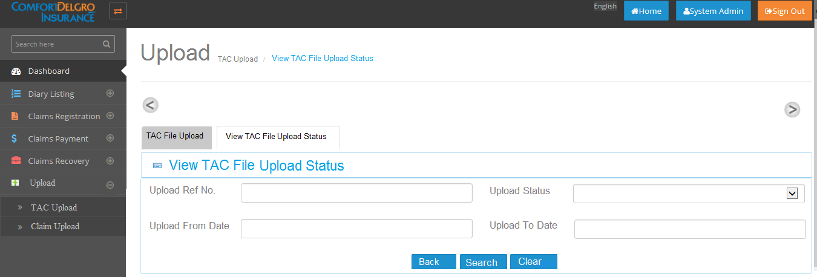
2) View TAC File Upload Status
2.1) Search Criteria Section (Partial Part of screen)

Slide 4
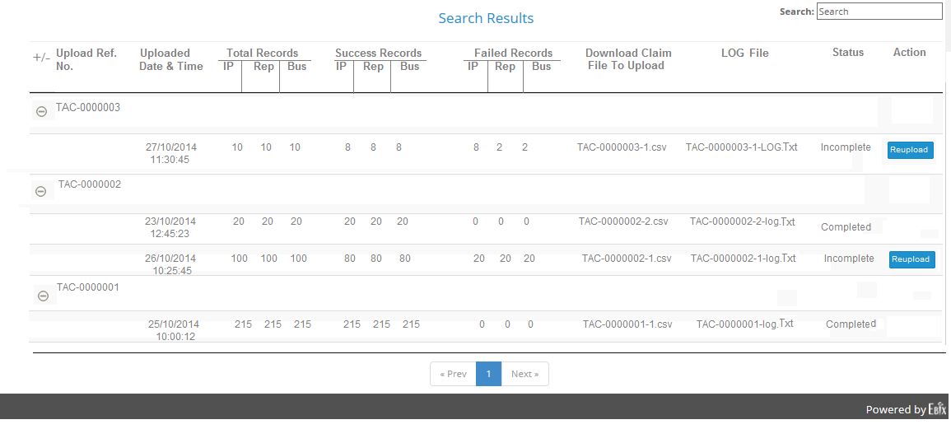
2.2) Search Result Section (Remaining party of screen)

Slide 5
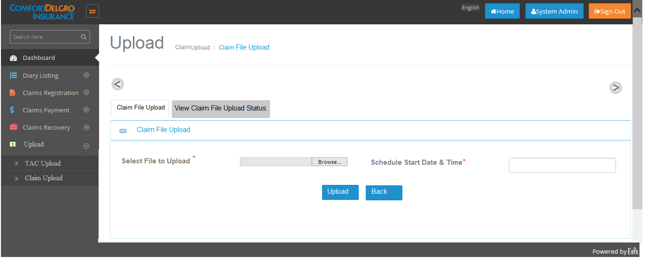
3) Claim File Upload Screen

Slide 6

4) View Claim File Upload Status
4.1)Search Criteria Section (Partial Part of screen)

Slide 7
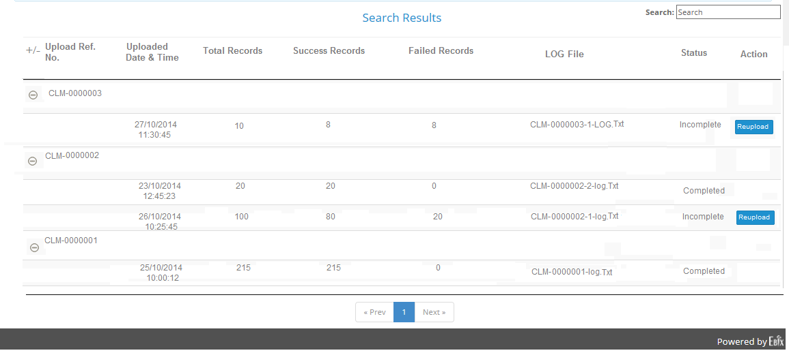
4.2) Search Result Section (Remaining party of screen)

Slide 8
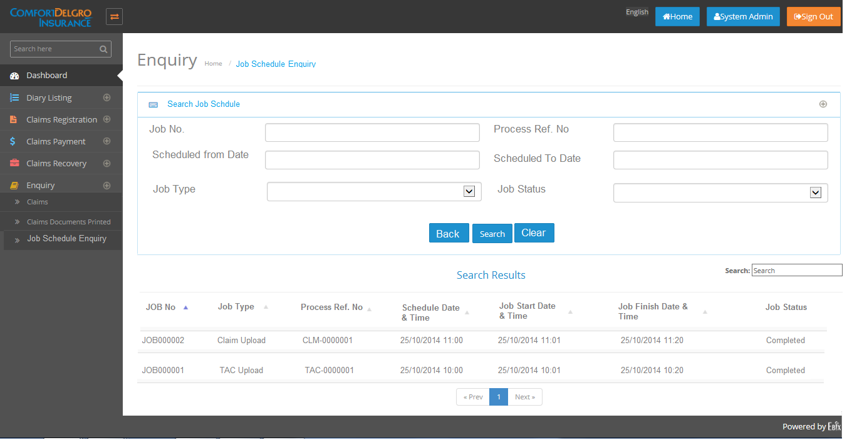
5) Job Schedule Enquiry

